Slide 1

Computer Architecture
A Quantitative Approach
Appendix A & C
Exceptions & Long Instructions

Slide 2
DEALING WITH UNEXPECTED SURPRISES
- APPENDIX C

Slide 3
Another Problem with Pipelining
Question: What makes pipelining hard to implement?
Answer: Surprises
Technical names for surprises:
  Exceptions
  Faults
  Interrupts

Slide 4
Exception (and Interrupt)
Exception: An unusual event happens to an instruction during its execution (caused by instruction execution)
  Request for I/O
  Arithmetic troubles: overflow or underflow
  Page fault: data not in (physical) memory
  Illegal address, giving a memory protection violation
  Hardware failure
Interrupt: Hardware signal to switch the processor to a new instruction stream (not directly caused by code)
Notes:
>>
Exceptional situations (surprises) are difficult to handle in a pipelined architecture.
In a pipelined CPU,
an instruction is executed through the various stages of the pipeline over many clock cycles.
If another instruction in the pipeline raises an exception,
it may force the CPU to abort the instructions in the pipeline before they complete.
Exception: …
Some types of exceptions are …
Interrupt: …

Slide 5
Classifying Exceptions
Synchronous: repeatable every time
  Example: DIV R2, R2, R0
Asynchronous: caused by external events like hardware failure and devices external to processor and memory
User requested: user task asks for it (e.g., breakpoint)
Coerced: cannot be predicted by user
User maskable: can be disabled by user task
  Example: arithmetic exception
Non-maskable: cannot be turned off
  Example: hardware failure
Notes:
>>
Events have important characteristics that determine what action is needed in the hardware
which place requirements on exceptions that can be classified in five ways.
Synchronous versus asynchronous
Synchronous:
Events that occur at the same location with the same data and memory allocation every time the program is executed.
Asynchronous:
Typically, events that are caused by devices external to the CPU and memory.
User requested versus coerced
User requested Exceptions:
The user task / application directly issues an exception that triggers an event.
User-requested exceptions can always be handled after the instruction has completed.
Coerced Exceptions:
Are caused by a hardware event that is beyond the control of the user program
and because of their unpredictability are more difficult to handle.
User maskable versus user non-maskable
User maskable:
An event that can be disabled by a user task.
A mask controls whether the hardware responds to the exception or not.
User non-maskable:
An event that cannot be disabled.
(e.g. such as a hardware failure)

Slide 6
Classifying Exceptions (cont.)
Within Instructions: prevents instruction from completing
Between Instructions: no instruction prevented
Terminating Event: stops the task
Resuming Event: task can continue
Machines that handle exceptions, save the state, and then restart correctly are said to be restartable.
Notes:
>>
Within versus between instructions
Within Instructions:
An event prevents instruction completion by occurring in the middle of execution.
Between instructions:
An event that is recognized between instructions.
It’s more difficult to handle exceptions that occur within instructions,
since the instruction must be stopped and restarted.
Resume versus terminate
Terminating event:
An event where the program’s execution always stops after an interrupt.
Resuming event:
An event where the program’s execution continues after an interrupt.
A pipeline that can:
handle exceptions,
save the state,
and restart correctly (without affecting the execution of the program)
is said to be restartable.

Slide 7
Categorizing Exceptions
Figure C.31
Exception type | Synch. vs. asynch. | User request vs. coerce | User maskable vs. not | Within vs. between instructions | Resume vs. terminate
I/O device request | Asynch | Coerced | Not | Between | Resume
Invoke OS | Synch | User req. | Not | Between | Resume
Tracing instructions | Synch | User req. | Maskable | Between | Resume
Breakpoint | Synch | User req. | Maskable | Between | Resume
Integer overflow | Synch | Coerced | Maskable | Within | Resume
Floating pt. overflow/ underflow | Synch | Coerced | Maskable | Within | Resume

Slide 8
Categorizing Exceptions (cont.)
Figure C.31
Exception type | Synch. vs. asynch. | User request vs. coerce | User maskable vs. not | Within vs. between instructions | Resume vs. terminate
Page fault | Synch | Coerced | Not | Within | Resume
Misaligned memory access | Synch | Coerced | Maskable | Within | Resume
Mem. prot. violation | Synch | Coerced | Not | Within | Resume
Undefined instruction | Synch | Coerced | Not | Within | Terminate
Hardware malfunction | Asynch | Coerced | Not | Within | Terminate
Power failure | Asynch | Coerced | Not | Within | Terminate

Slide 9
The most difficult exceptions...
... are those that occur within EX or MEM stages and also must be handled in a restartable way
Steps to save the pipeline state safely:
  Force the next IF to get a "trap instruction"
  Until the trap is taken, turn off all "writes" for the faulting instruction and for all instructions that follow it.
  What does the trap do?
» The trap transfers control to the exception handling routine in the operating system, which saves the PC of the faulting instruction and handles the fault
  The task is then resumed,
  using the saved PC and the MIPS instruction RFE
Note: May need to save several PCs if delayed branches are involved
Notes:
>>
The most difficult exceptions
are those that occur within EX or MEM stages
and also, must be handled in a restartable way.
Steps to save the pipeline state safely:
1. …
Trap Instruction:
A trap instruction is a mechanism used in pipelined processors to handle exceptional conditions.
2. …
Turn off all “writes”:
Done by placing zeros into the pipeline latches of all instructions in the pipeline,
starting with the instruction that generates the exception.
3. …
The MIPS instruction RFE (Return From Exception):
is used to return the processor from an exception handler to its previous state.
…

Slide 10
Precise Exception Handling
Must seem as if the exception or interrupt appeared between 2 instructions (I_{i} and I_{i+1}) although several instructions were executing at the time
  All instructions before I_{i-1} (inclusive) are totally completed
  No effect of any instruction after I_{i} is allowed to be saved
After a precise interrupt handling, the interrupt (exception) handler either aborts the program or restarts at instruction I_{i+1}
Notes:
>>
Precise exceptions:
A pipeline is said to have precise exceptions
if it can be stopped such that all instructions preceding the faulting instruction are completed,
and all instructions following it can be restarted from scratch

Slide 11
When do MIPS exceptions occur?
Pipeline Stage
Exceptions
IF
Page fault, misaligned memory access, memory-protection violation
ID
Undefined or illegal opcode
EX
Arithmetic exception
MEM
Page fault, misaligned memory access, memory-protection violation
WB
None!!!

Slide 12
Example 1 of Exception Handling
This pair of instructions can cause a data page fault and an arithmetic exception at the same time.
LD | IF | ID | EX | MEM | WB
ADD |  | IF | ID | EX | MEM | WB
Handle the MEM fault first, then restart
Notes:
…
This pair of instructions can cause a data page fault and an arithmetic exception at the same time.
This case can be handled by dealing with only the data page fault and then restarting the execution.

Slide 13
Example 2 of Exception Handling
ADD causes a memory exception in IF 2 cycles before the LD data page fault in MEM
LD | IF | ID | EX | MEM | WB
ADD |  | IF | ID | EX | MEM | WB
IF fault occurs first, even though LD will fault later
But for precise exceptions, must handle LD fault first
Notes:
…
This case can be handled by dealing with only the data page fault and then restarting the execution.

Slide 14
How is this done?
Answer: Don't handle exceptions until the WB stage
  Each instruction has an associated status vector that keeps track of faults
  Any bit set in the status vector turns off register writes and memory writes
  In WB stage:
  the status vector is checked
  and any fault is handled
  So, since instructions reach WB in proper order, faults for earlier instructions are handled before faults for later instructions
» Unfortunately, will need to violate this later (for instructions that don’t reach WB in proper order)
Notes:
…
(Exceptions may occur out of order.)

Slide 15
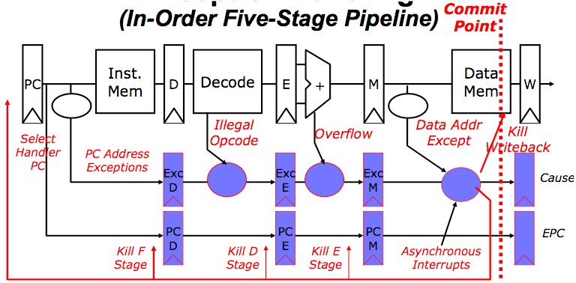
Precise Exceptions in Static Pipelines
Stages:
F
D
E
M
W
Fetch Decode Execute
Key observation: “Architected” states change only in memory (M) and register write (W) stages.

Slide 16
Commitment
When an instruction is guaranteed to complete, it is committed
Life is easier if no instruction changes the permanent machine state before it is committed
In MIPS, commitment occurs at the end of the MEM stage
  - that’s why register update occurs in the stage after that
Notes:
>>
MIPS pipeline writes that result only at the end of an instruction’s execution.
When an instruction is guaranteed to complete, it is called committed.
In the MIPS integer pipeline,
all instructions are committed when they reach
the end of the MEM stage (or beginning of WB).
Thus, precise exceptions are straightforward.

Slide 17
INSTRUCTION SET COMPLICATION
- APPENDIX C

Slide 18
Complications with long instructions
So far, all MIPS instructions take 5 cycles
But haven't talked yet about the floating point instructions
Take it on faith that floating point instructions are inherently slower than integer arithmetic instructions
– doubters may consult Appendix J

Slide 19
Functional Units
Figure C.33
EX Int
EX div
Notes:
>>
This diagram illustrates the MIPS pipeline with three additional unpipelined, floating-point, functional units.
A functional unit is
a specialized hardware component within the processor responsible for performing a specific type of operation.
Because only one instruction issues on every clock cycle,
all instructions go through the standard pipeline for integer operations.
The FP operations simply loop when they reach the EX stage.
After they have finished the EX stage,
they proceed to MEM and WB to complete execution.

Slide 20
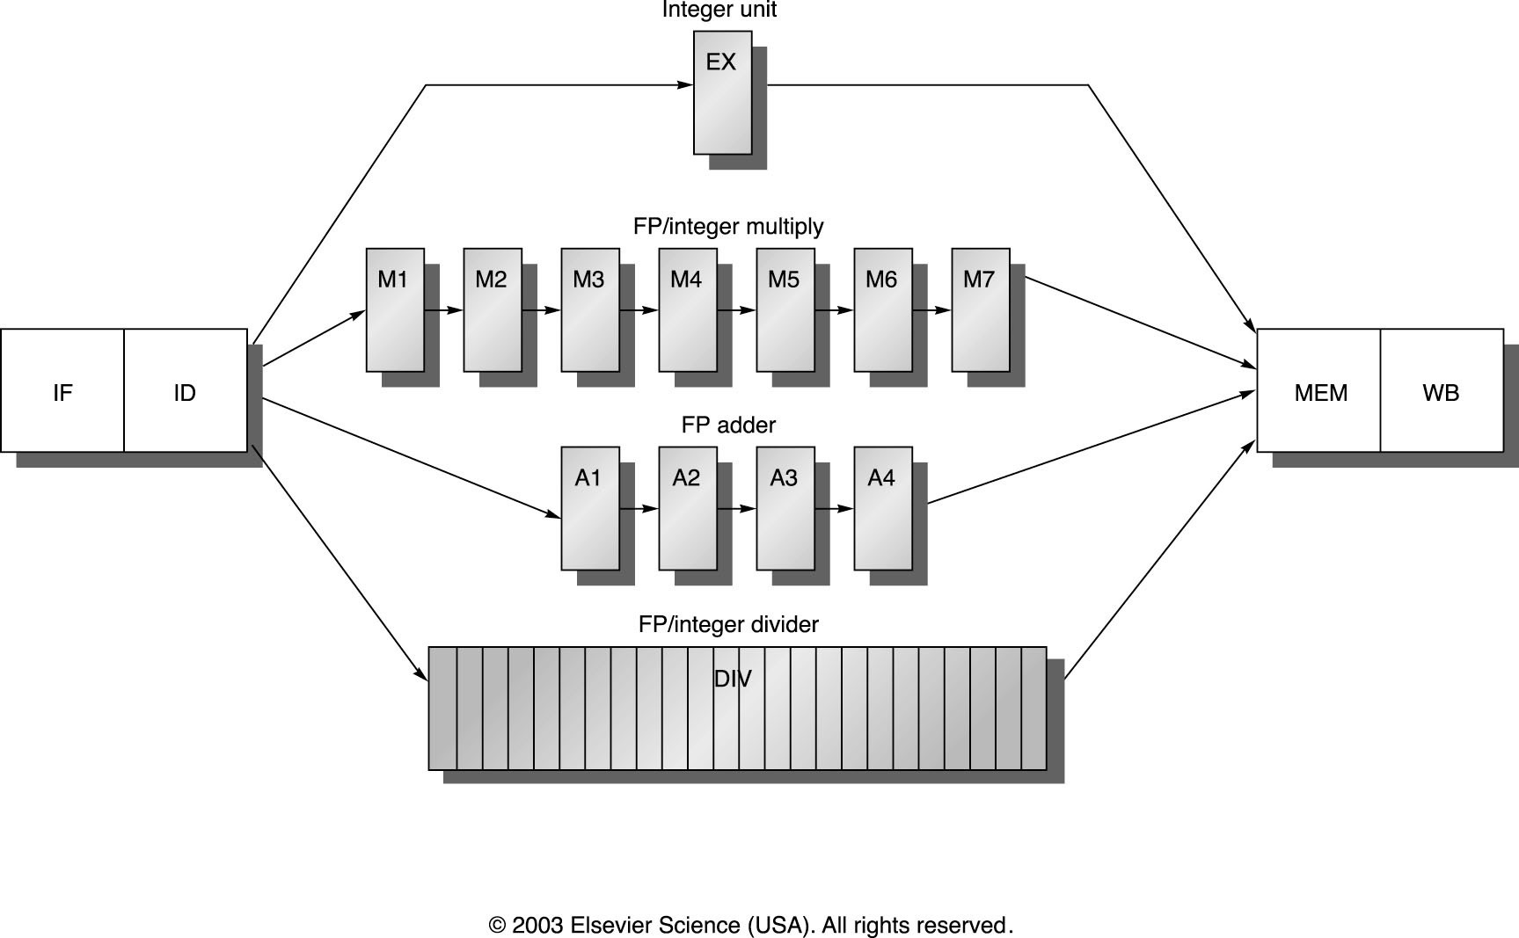
Functional Units
Figure C.35
non-pipelined DIV.D instruction stalls the pipeline for 24 cycles
Notes:
>>
A pipeline that supports multiple FP operations.
The FP multiplier and adder are fully pipelined and have a depth of seven and four stages, respectively.
The FP divider is not pipelined but requires 24 clock cycles to complete.
The latency in instructions between the issue of an FP operation
and the use of the result of that operation without incurring a RAW stall
is determined by the number of cycles spent in the execution stages.
For example,
the fourth instruction after an FP add can use the result of the FP add.
For integer ALU operations,
the depth of the execution pipeline is always one and the next instruction can use the results.

Slide 21
How slow is slow?
Some typical times:
  latency is the number of cycles between an instruction that produces a result and one that uses it
  initiation interval is the number of cycles between issuing two instructions of the same kind
  (for example, two ADD.Ds)
Instruction Type | Latency | Initiation
Integer ALU | 0 | 1
Data memory (load) | 1 | 1
ADD.D / SUB.D | 3 | 1
MUL.D | 6 | 1
DIV.D | 24 | 25
Example latencies and initiation intervals for functional units (Fig. C.34)

Slide 22
Examples
If have a series of instructions:
  ADD
  SUB
  AND
  OR
  SLLI
Then, no delays in the pipeline, because
  Results from one instruction will be available when the next instruction needs them without stall
  Instructions can be issued to EX stage every cycle
Notes:
Assume forwarding is enabled.

Slide 23
Examples (cont.)
Suppose have a stream of instructions
  ADD.D
  SUB.D
Initiation interval = 1 means that SUB.D can start one cycle behind ADD.D -- assuming no dependence
Latency = 3 means that 3 stalls will be needed if SUB.D needs the result from ADD.D
  i.e., If it does need the results, then need 3 instructions in between ADD.D and SUB.D to prevent bubbles in the pipeline

Slide 24
Review Question
Assume that the execution of MUL.D instruction is fully pipelined on an architecture, and it takes 7 cycles for execution. What is the latency between the following two instructions?
MUL.D F10, F9, F8
ADD.D F9, F10, F8
Notes:
The latency between the MUL.D and ADD.D instructions is 6 cycles.
This is because the ADD.D instruction depends on the result of the MUL.D instruction.

Slide 25
Examples (cont.)
Figure C.36
MUL.D | IF | ID | M1 | M2 | M3 | M4 | M5 | M6 | M7 | MEM | WB
ADD.D |  | IF | ID | A1 | A2 | A3 | A4 | MEM | WB
L.D |  |  | IF | ID | EX | MEM | WB
S.D |  |  |  | IF | ID | EX | MEM | WB
Italics shows where data is needed (when forwarding is in use), blue where a result is available
Notes:
>>
The pipeline timing of a set of independent FP operations.
The stages in italics show where data are needed,
while the stages in blue show where a result is available.
The ”.D” extension on the instruction mnemonic indicates
double-precision (64-bit) floating-point operations.
FP loads and stores use a 64-bit path to memory so
that the pipelining timing is just like an integer load or store.

Slide 26
Hazards caused by long instructions
The FP adder and FP/Integer multiplier are pipelined, but the divider is not (initiation interval: 25)
– A program will run very slowly if it does too many of these!
It will also run slowly if the results of the divide are needed too soon (RAW hazards)

Slide 27

FP stalls from RAW hazards – Fig. C.37
Inst. | 1 | 2 | 3 | 4 | 5 | 6 | 7 | 8 | 9
L.D F4, 0(R2) | IF | ID | EX | MEM | WB
MUL.D F0,F4,F6 |  | IF | ID | stall | M1 | M2 | M3 | M4 | M5
ADD.D F2,F0,F8 |  |  | IF | stall | ID | stall | stall | stall | stall
S.D F2, 0(R2) |  |  |  | stall | IF | stall | stall | stall | stall
Inst. | 10 | 11 | 12 | 13 | 14 | 15 | 16 | 17
L.D F4, 0(R2)
MUL.D F0,F4,F6 | M6 | M7 | MEM | WB
ADD.D F2,F0,F8 | stall | stall | A1 | A2 | A3 | A4 | MEM | WB
S.D F2, 0(R2) | stall | stall | ID | EX | stall | stall | stall | MEM
Notes:
>>
Here is an example of a typical FP code sequence showing the stalls arising from RAW hazards.
The longer pipeline substantially raises the frequency of stalls versus the shallower integer pipeline.
Each instruction in this sequence is dependent on the previous
and proceeds as soon as data are available,
which assumes the pipeline has full bypassing and forwarding.
The S.D must be stalled an extra cycle so that
its MEM does not conflict with the ADD.D.
Extra hardware could easily handle this case.

Slide 28
Structural Hazard from Long instructions
ADD.D | IF | ID | A1 | A2 | A3 | A4 | MEM | WB
LD |  | IF | ID | ALU | MEM | WB
DADD |  |  | IF | ID | ALU | MEM | WB
DADD |  |  |  | IF | ID | ALU | MEM | WB
Notes:
>>
Does anybody see a problem with this timing chart?

Slide 29
Structural Hazard from Long instructions
It is possible that two instructions enter a WB stage at the same time
ADD.D | IF | ID | A1 | A2 | A3 | A4 | MEM | WB
LD |  | IF | ID | ALU | MEM | WB
DADD |  |  | IF | ID | ALU | MEM | WB
DADD |  |  |  | IF | ID | ALU | MEM | WB
Notes:
>>
Two instructions want to perform a write-back to the FP register file at the same time.

Slide 30
Long instructions - WAW structural Hazard
Instructions can finish in the wrong order
– can cause WAW hazards
 | 1 | 2 | 3 | 4 | 5 | 6 | 7 | 8 | 9 | 10 | 11
MUL.D F0,F4,F6 | IF | ID | M1 | M2 | M3 | M4 | M5 | M6 | M7 | MEM | WB
… |  | IF | ID | EX | MEM | WB
… |  |  | IF | ID | EX | MEM | WB
ADD.D F2,F4,F6 |  |  |  | IF | ID | A1 | A2 | A3 | A4 | MEM | WB
… |  |  |  |  | IF | ID | EX | MEM | WB
… |  |  |  |  |  | IF | ID | EX | MEM | WB
L.D F2,0(R2) |  |  |  |  |  |  | IF | ID | EX | MEM | WB
Notes:
>>
(Figure C.38)
Here is an example when three instructions want to perform a write-back to the FP register file simultaneously
(shown in clock cycle 11)
This is not the worst case,
since an earlier divide in the FP unit could also finish on the same clock.
Note that although the MUL.D, ADD.D, and L.D
all are in the MEM stage in clock cycle 10,
only the L.D actually uses the memory.
So, no structural hazard exists for MEM.

Slide 31
Long instructions - WAW structural Hazard
Instructions can finish in the wrong order
– can cause WAW hazards
 | 1 | 2 | 3 | 4 | 5 | 6 | 7 | 8 | 9 | 10 | 11
MUL.D F0,F4,F6 | IF | ID | M1 | M2 | M3 | M4 | M5 | M6 | M7 | MEM | WB
… |  | IF | ID | EX | MEM | WB
… |  |  | IF | ID | EX | MEM | WB
ADD.D F2,F4,F6 |  |  |  | IF | ID | A1 | A2 | A3 | A4 | MEM | WB
… |  |  |  |  | IF | ID | EX | MEM | WB
… |  |  |  |  |  | IF | ID | EX | MEM | WB
L.D F2,0(R2) |  |  |  |  |  |  | IF | ID | EX | MEM | WB
Notes:
>>
(Figure C.38)
Here is an example when three instructions want to perform a write-back to the FP register file simultaneously
(shown in clock cycle 11)

Slide 32
Long instructions (cont.)
Instructions can finish in the wrong order
This can cause WAW hazards
This violation of WB ordering defeats the previous strategy for precise exception handling
– problem is out-of-order completion
stop fetching
turn off writes
let pipeline drain
handle
Does this scheme work?
This example is from page C-58 (H&P 5th)
DIV.D ADD.D SUB.D
F0, F2, F4 F10, F10, F8 F12, F12, F14
And then div faults? Completed already
What happens if sub faults?
What about F10? Original value is lost!!
Notes:
…
Example from (C-58):
There are no dependences, so the code sequence looks straight forward.
However, a problem arises
because an instruction issued early may complete after an instruction issued later.
ADD.D and SUB.D will complete before the DIV.D is finished.
(Note that F10 is updated after ADD.D completes.)
This is called out-of-order completion.
(Common in pipelines with long-running operations)
(Hazard detection will handle dependence. So, what is the problem?)
Suppose that the SUB.D causes a floating-point arithmetic exception
at a point where the ADD.D has completed but the DIV.D has not.
The result will be an imprecise exception.
It may appear that this could be handled by letting the floating-point pipeline drain,
as we do for the integer pipeline.
But the exception may be in a position where this is not possible.
For example,
if the DIV.D decided to take a floating-point-arithmetic exception after the add completed,
a precise exception at the hardware level is not possible.
In fact, because the ADD.D destroys one of its operands,
we will be unable to restore the state to what it was before the DIV.D.
This problem arises because instructions are completing in a different order than they were issued.

Slide 33
Possible fixes
Give up and just do imprecise exception handling
  tempting, but very annoying to users
Delay WB until all previous instructions complete
  since so many instructions can be active, this is expensive - requires a lot of supporting hardware
Write, to memory, a history file of the register and memory changes so can undo instructions if necessary
  or keep a future file of computed results that are waiting for MEM or WB

Slide 34
Possible fixes (cont.)
Have the floating-point units diagnose exception possibility in their early in the EX stages, so can handle them by methods that work well for handling integer exceptions
  Allows the instruction issue to continue only if it is certain that all the instructions before the issuing instruction will complete without causing an exception.
  Guarantees that when an excep- tion occurs, no instructions after the interrupting one will be completed and all of the instructions before the interrupting one can be completed

Slide 35
What hazards to detect in ID
Early detection would prevent trouble
Check for structural hazards:
  Will the divide unit clear in time?
  Will WB be possible when we need it?
Check for RAW data hazards:
  Will all source registers be available when needed?
Check for WAW data hazards:
  Is the destination register for any ADD.D, multiply or divide instruction the same register as the destination for this instruction?
If anything dangerous could happen, delay the execute cycle (i.e., delay issue to EX), so no conflict occurs

